Slide 1
Hotel Booking Analysis
CAPSTONE PROJECT
Presented By:
DINESH P - Knowledge Institute of Technology - B.E EEE

Slide 2
OUTLINE
Problem Statement (Should not include solution)
Proposed System/Solution
System Development Approach (Technology Used)
Algorithm & Deployment
Result
Conclusion
Future Scope
References

Slide 3
Problem Statement
Have you ever wondered when the best time of year to book a hotel room is? Or the optimal length of stay in order to get the best daily rate? What if you wanted to predict whether or not a hotel was likely to receive a disproportionately high number of special requests? This hotel booking dataset can help you explore those questions! This data set contains booking information for a city hotel and a resort hotel, and includes information such as when the booking was made, length of stay, the number of adults, children, and/or babies, and the number of available parking spaces, among other things. All personally identifying information has been removed from the data. Explore and analyze the data to discover important factors that govern the bookings.

Slide 4
Project Summary
In this project we began to explore the dataset in which Hotel Booking comprises of two types of hotels i.e City Hotel and Resort Hotel.
In this dataset, there are 119390 rows and 32 columns.
All the columns are divided into three dtypes : Object, float64 and int64.
In this dataset, there are both duplicates and missing values available. So, we have to deal with that and as a result i have replaced the null and missing values and also i dropped the duplicate values.
The maximum number of missing values are from 'Company' column then followed by 'Agent','Country' and 'Children' columns. The 'Children' column consists of only 4 null values while 'Company' column consists of 112593 null values.
This project, i divided the data manipulation workflow into three categories i.e. Data Collection, Data cleaning & manipulation and EDA(Exploratory Data Analysis).
In moving further, i have used various basic functions and attributes i.e Data collections first step to find different columns which is done by various methods like Head(), tail(), info(), describe(), columns() and some others method used for data collections.
As i further moved, i check the number of unique values of each columns and generate a list of those values and then also find the unique values of each columns later on.

Slide 5
Then further i converted the datatypes of columns into appropriate datatype. I added some of the columns name here, one is 'total_people' and other is 'total_stay'.
Find some columns are not in accurate data types which correct it later, done in Data cleaning part and as well as duplicates data items must be removed as i find duplicate items equal to 31994 which is dropped from dataset later.
I found that there were some rows in which the combining values of adults, babies and childrens was 0, so this simply means there were no guests as 0 indicates presence of none. So, there were no bookings made. As a result, i simply dropped the rows where combining values of adults, babies and children columns was 0.
The data type of 'reservation_status_date' column was object type, so it was changed to date type format for better use.
Before visualizing any data from the data set we have to do data wrangling. For that, i have checked the null value of all the columns. After checking, when i find minimal number of null values, filling these null values with necessary values as per requirement by using fillna().
So, after completing the process of data wrangling, i moved to the data visualization part.
In the data visualization process, i have used various charts and have dived deep understanding the graphs to catch the proper insights from the data. That gives the business outcomes which will ultimately boost the businesses.
So, i explored and analyzed the data to discover important factors that govern the bookings.

Slide 6
Proposed Solution
DATA COLLECTION
Here we will going through each variable & will do proper understanding of each variable of data. & Import a data to further process.
DATA CLEANING & MANIPULATION:
Data Cleaning means the process of identifying the incorrect, incomplete, inaccurate, irrelevant or missing part of the data and then modifying, replacing or deleting them according to the necessity.
EDA & VISUALIZATION:
Exploratory Data Analysis (EDA) is a process of describing the data by means of statistical and visualization techniques in order to bring important aspects of that data into focus for further analysis.

Slide 7
System Approach
A combination of feature engineering, machine learning, and data processing would be used to build the suggested solution. The essential system and library requirements are as follows:
System Requirements:
1. Hardware:
A powerful enough computer, ideally with many cores or a GPU to speed up the training of machine learning models.
Enough RAM to meet the computing demands and the size of the dataset.
2. Software:
An OS (such as Windows, Linux, or macOS) that is compatible with the necessary machine learning libraries.

Slide 8
Library Requirements:
1. Data Analysis and Processing:
Pandas: For analysis and data processing.
NumPy: For data operations involving numbers.
2. Data Visualization:
Matplotlib and Seaborn: For building data-pattern visualizations.
For more intricate visualizations, use the interactive visualization tools Plotly or Bokeh.

Slide 9
Algorithm & Deployment
Data Exploration:
Examine the features, structure, and target variable(s) of the hotel booking dataset.
Determine any possible outliers, relationships, and patterns.
Problem Formulation:
Describe the issue: Based on past performance, forecast the best times to book, the perfect duration of stay, and the possibility of unique requests.
Regression assignments (such forecasting a day's date):
Think about decision trees, linear regression, or ensemble techniques (XGBoost. LightGBM).
Sorting assignments (such as anticipating particular requests):
Think about random forests, decision trees, or logistic regression.

Slide 10
Data Collection:
Compile past hotel booking data, such as dates of booking, duration of stay, special requests, guest profiles, and other hotel information.
Data Cleaning:
Address outliers, missing values, and any discrepancies in the dataset.
Use encoding techniques to translate category information into numerical representations.
Feature Engineering:
Build new features or alter current ones using domain expertise.
Date variables can be used to extract important information, like the day of the week or month.

Slide 11
Training Process:
Data Splitting:
Split the dataset into testing and training sets so you can assess the model's effectiveness.
Feature Scaling:
To guarantee that numerical features have a constant scale, standardize or normalize them.
Model Training:
Train the model on the training dataset using the chosen algorithm.
To enhance the model's performance, modify its hyperparameters.
Model Evaluation:
Utilizing the proper metrics (e.g., Mean Squared Error for regression, accuracy, precision, recall for classification), evaluate the model on the testing dataset.
Adjust the model as needed.

Slide 12
Prediction Process
New Data Input:
Compile fresh data or forecast using already-existing data.
Preprocessing:
Apply the same feature engineering, scaling, and cleaning data preprocessing methods to the new data.
Model Inference:
Utilize the trained model to forecast the fresh data.
Results Interpretation:
Analyze the model's predictions in relation to the current issue.
Interpret the projected values for regression as the ideal rates or durations of stay. Preffictions should be interpreted as the possibility of specific requests for classification.

Slide 13
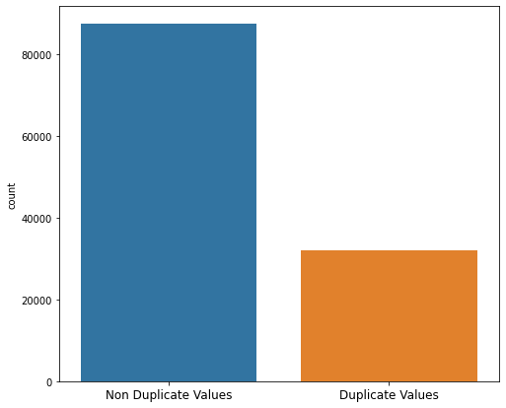
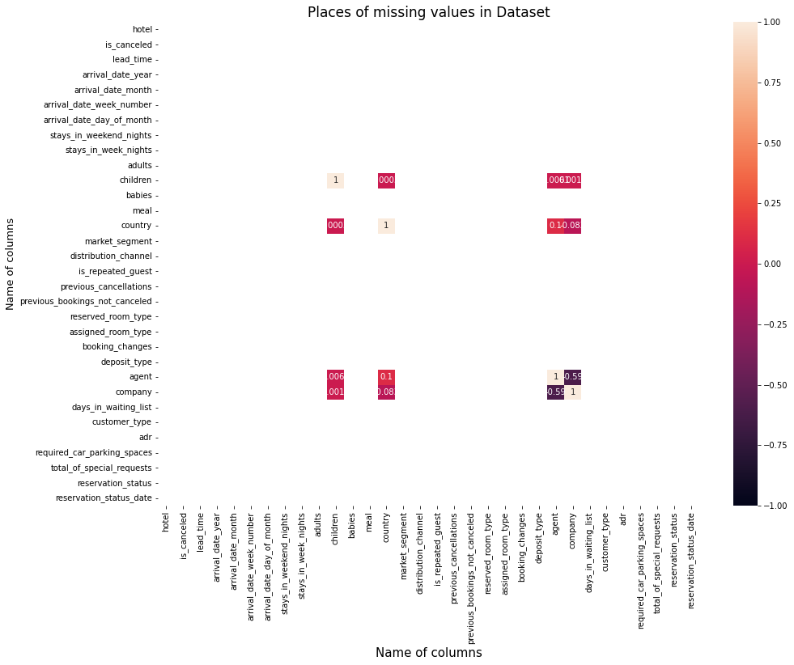
Result

Slide 14
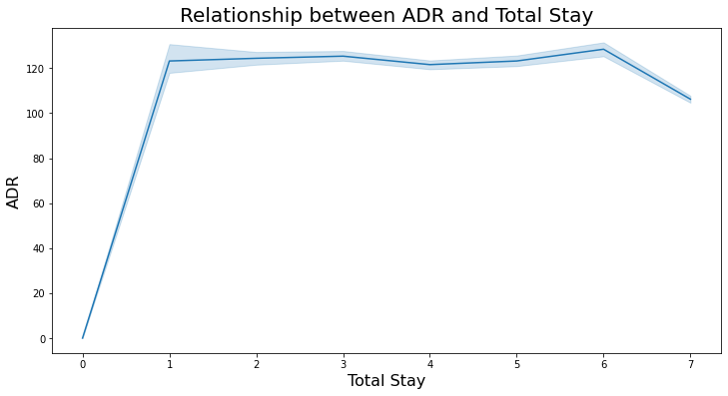
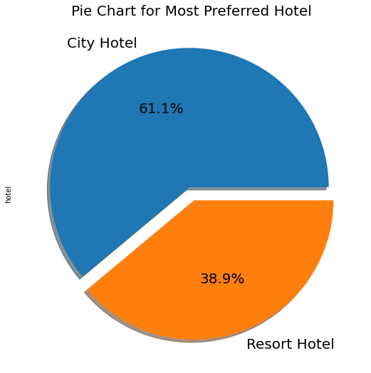
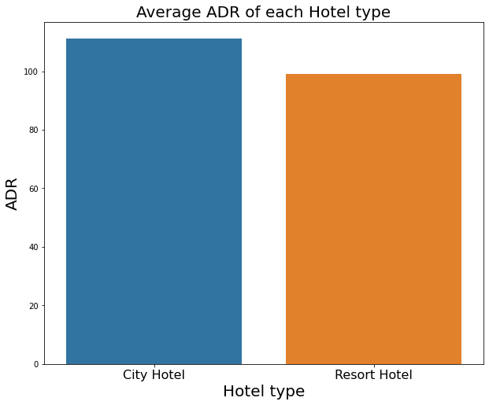
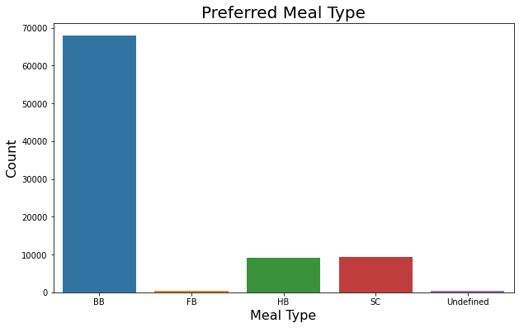
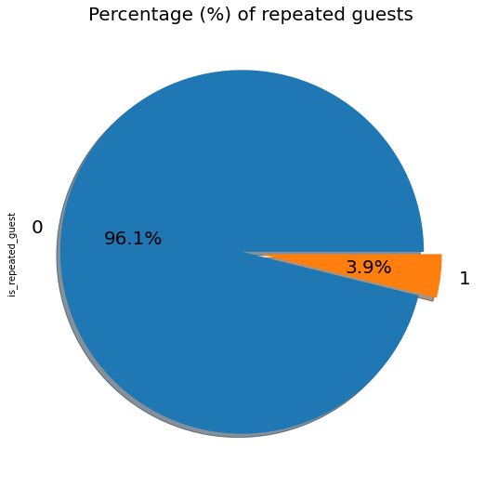
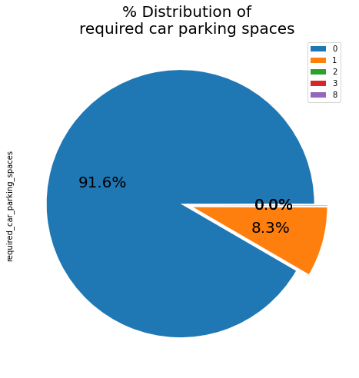
Data Vizualization, Storytelling & Experimenting with charts

Slide 15
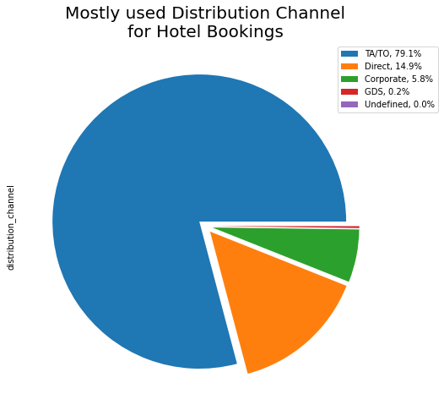
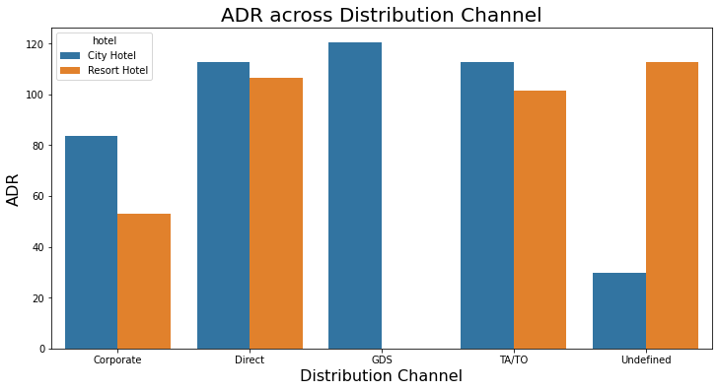
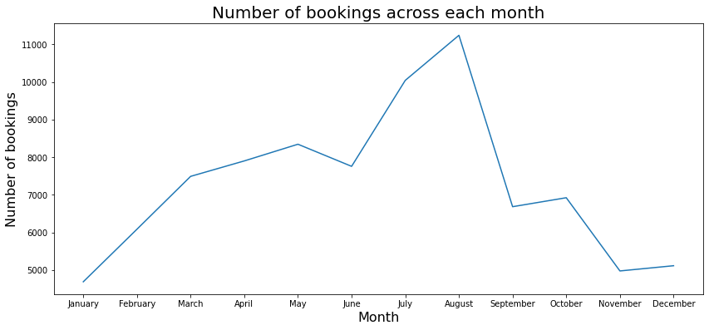
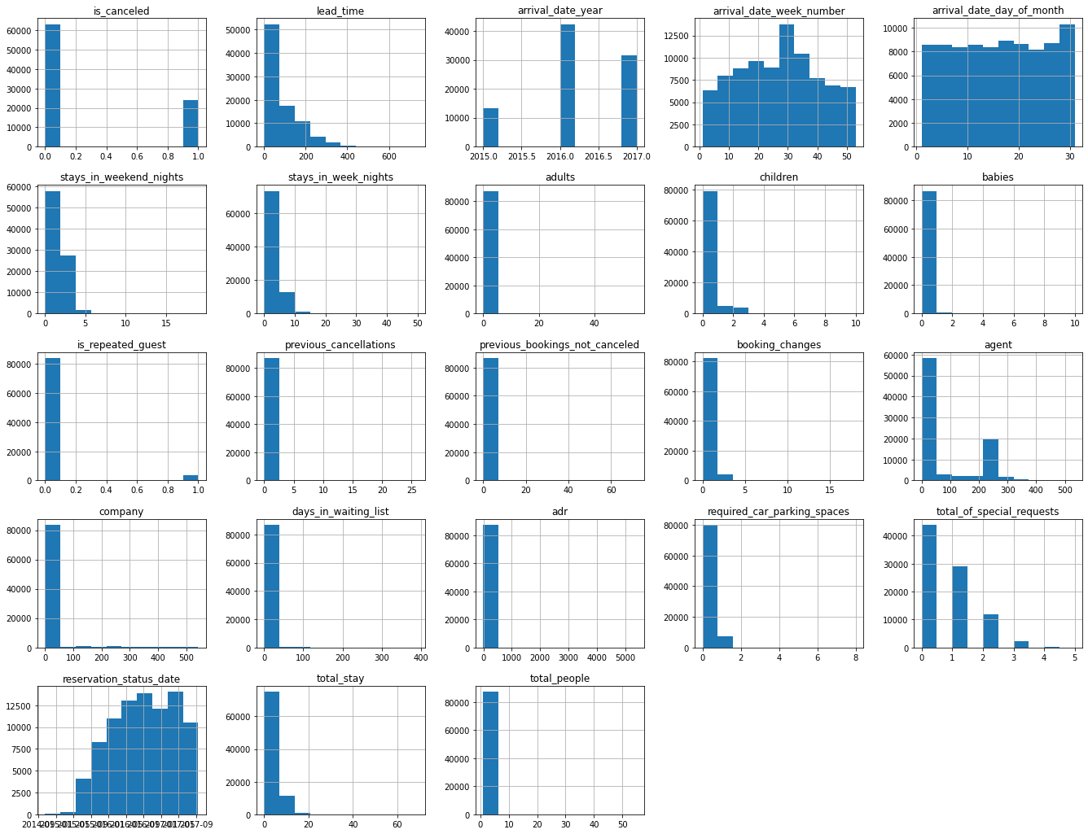
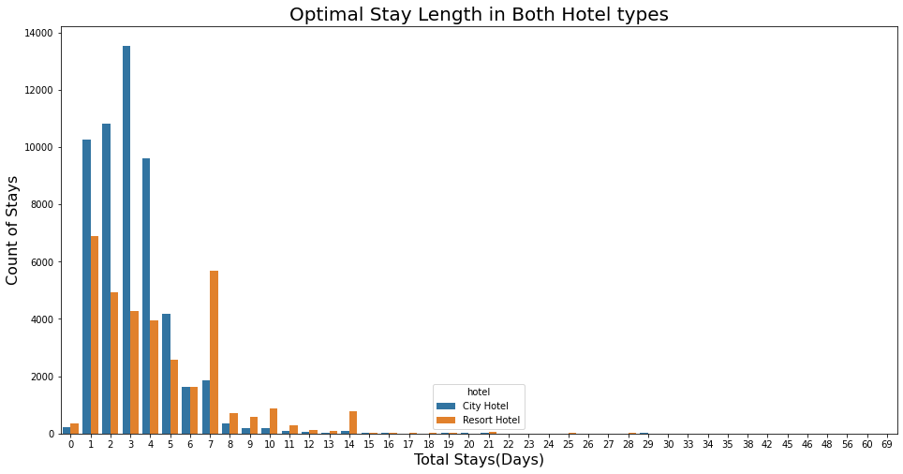

Slide 16
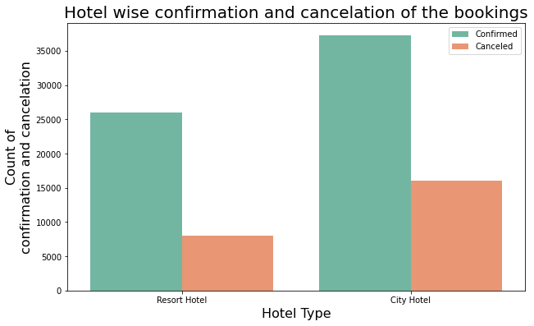
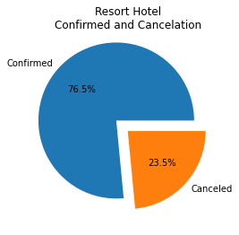
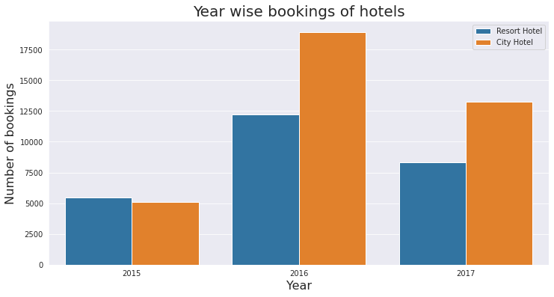
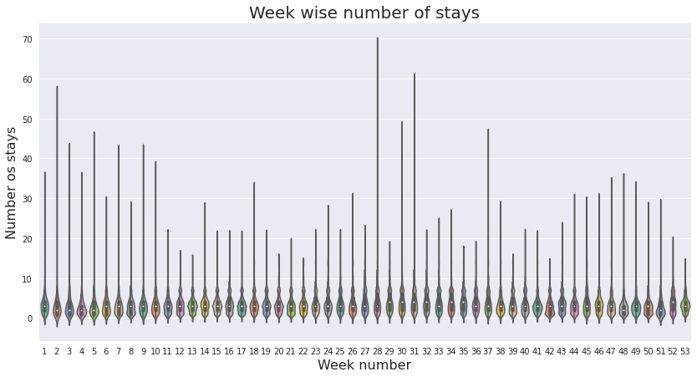
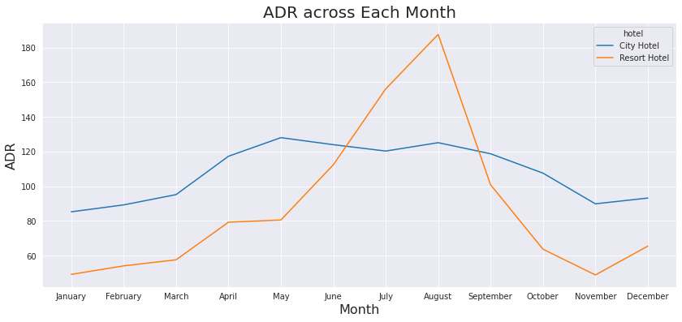

Slide 17
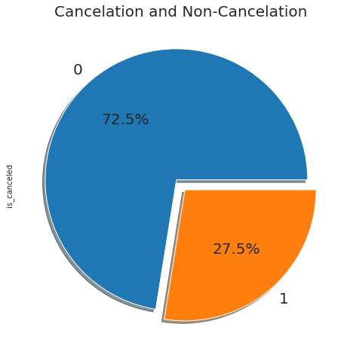
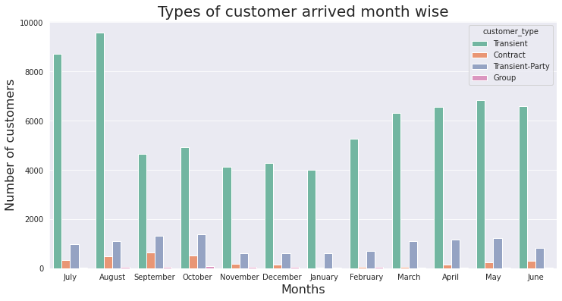
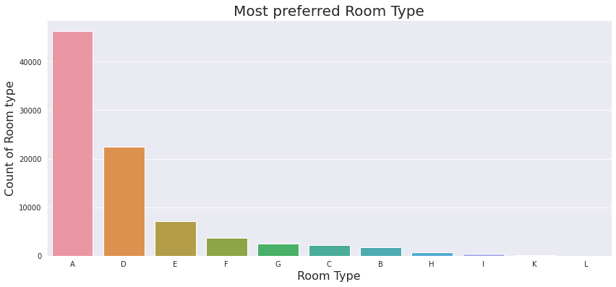
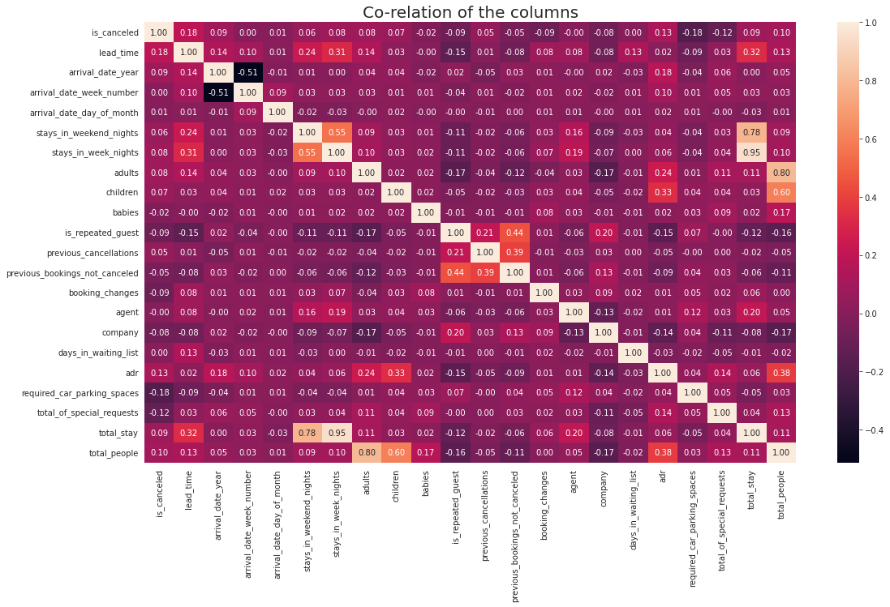

Slide 18
1. To attain high growth and more success, hotel business need to flourish and for that few things which we need to consider is high revenue generation, customers satisfaction and employeee retention.
2. We are able achieve the same by showing the client which are the months which are high in revenue generation by using various charts and graphs distribution.
3. Enhancing the revenue adopted by bar chart distribution of which type room are most preferred and reserved and which are the months suitable for visitors.
4. We also have founded the various preferences in different categories like most liked meal type, optimal stay length, facilities required by customers like car parking spaces, etc. So, all these insights ultimately add to have a better planning for growth and higher revenue.
5. So, preparing well by using and understanding these useful outcomes, the client can be well prepare in advance so that minimum grievances would be faced by clients in long run and would help in further enhancement of their hospitality and service.
6. Ask for feedback often from the guests visiting the hotels so that the quality can be upgraded to the next level to increase more guests.
7. Periodically throw offers to attract the old customers so as to increase the number of repeated guests.

Slide 19
Conclusion
City hotels are the most preferred hotel type by the guests. So, we can say that City hotels are the busiest hotel in comparison to the resort hotel.
The average ADR of city hotels is higher as compared to the resort hotels. So, it can be said that these City hotels are generating more revenue than the resort hotels.
The total stay of guests is directly proportional to the adr. So, higher the days of stay, the higher will be ADR and revenue as well.
The percentage of repeated guests is very low. Only 3.9% people had revisited the hotels. Rest 96.1% were new guests. So, retention rate is much low.
The percentage of required car parking spaces is very low. This means less car parking spaces don't affect the business much. Most of the customers (91.6%) do not require car parking spaces.
Among different types of meals, BB (Bed & Breakfast) is the most preferred type of meal by the guests. So, guests love to opt for this meal type.

Slide 20
'Direct' and 'TA/TO' have almost equally contribution in ADR in both type of hotels i.e. 'City Hotel' and 'Resort Hotel'. While, GDS has highly contributed in ADR n 'City Hotel' type.
Optimal stay length in both the hotel types (City and Resort Hotel) is less than 7 days. Usually people stay for a week. So, after 1 week, the optimal stay length declined drastically.
Most number of bookings have taken place in the month of July and August. July and August are the favourite months of guests to visit different places.
The mostly used distribution channel for booking is 'TA/TO'. 79.1% bookings were made through TA/TO (travel agents/ tour operators).
While calculating ADR across different month, it is found that for Resort hotel, ADR is high in the months of June, July, August as compared to City Hotels.
Almost 1/4th of the total bookings is canceled. Approx, 27.5% bookings have got canceled out of all the bookings.
Majority of the guests have shown interest in the room type 'A'. Room type 'A' is the most preferred room type.

Slide 21
Future scope
The solution that has been suggested establishes the groundwork for further developments in the field of hotel reservation optimization. The following are important areas for further research and development.
Real-time Predictions:
Adopt real-time predictive models that take into consideration sudden variations in demand, outside circumstances, and other dynamic elements to give users the most recent information possible when making reservations.’
Personalization and Customization:
Improve the predictive algorithms to provide more customized recommendations by taking into account the preferences of specific guests, past loyalty, and user-specific needs, making each traveler's experience unique.

Slide 22
References
https://www.kaggie.com/datasets
https://pandas.pydata.org/pandas-docs/stable/user_guide/index.html
https://seaborn.pydata.org/
https://matplotlib.org/stable/contents.html

Slide 23
THANK YOU

